Slide 1
Marble Falls High School Course Registration for 2024-2025

Slide 2
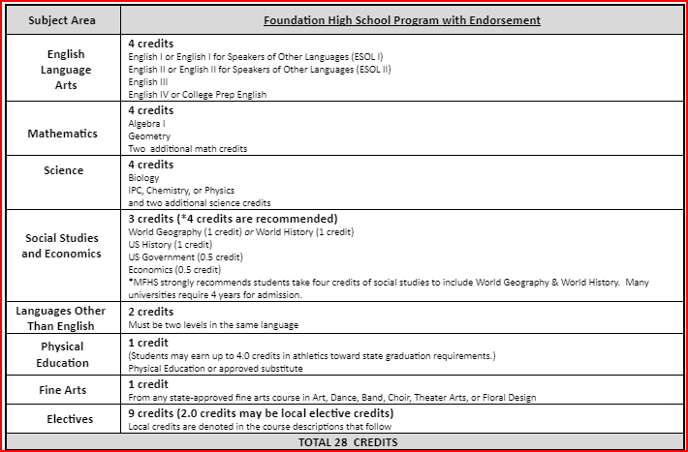
Graduation Requirements:
Red (recommneded) - Colleges may require these courses
Algebra 2
Recommend including Chem., Physics and 4th science
Recommend World Geography AND World History (all 4 credits of Social Studies)
Some colleges view 3 years of a Foreign language as a plus!

Slide 3
Check your transcript!
Check Skyward for your transcript under the portfolio tab!
Look for required credits that you need to graduate, including credits you did not earn because of failing grades or because you owe hours.
You can complete credit for failed courses through credit recovery, long-averaging, summer school, or re-taking the course next year.
Counselors will verify your choices with you individually prior to Spring Break to ensure you are choosing the classes you need to graduate.

Slide 4
Advanced Courses Comparison (courses may have a fee)
AP - World History available as a 10th grader
On Ramps - OnRamps Chemistry and possibly Algebra 2 available.
High school credit
Universities award credit for exam score of 3 or higher at Texas schools
College Board Curriculum
2 points added to passing grades for GPA
Can be dropped at 4 weeks and semester only
High school AND college credit, with an option to decline college grade
Will receive a grade for HS AND separate college grade
UT curriculum
2 points added for GPA
Can be dropped at semester only

Slide 5
Advanced Classes Presentation
Meeting for parents will be scheduled for the Spring!
An email will be sent out with the date and time.
Check your email!

Slide 6
Distinguished Level of Achievement
Complete the Foundation Requirements
Complete Algebra 2
Earn an endorsement
Required for top 10% automatic admission to Texas public colleges.

Slide 7
Important Elective Information
Some electives have prerequisites. Prerequisites are courses that you must complete or take concurrently while you are in that class. Courses with prerequisites should not be available for you to choose in School Links.
Never select a class that you already have credit for on your transcript!
Some electives require an application.
Some courses are 2 periods in your schedule.
Consider weighted courses for GPA boosts (Honors/AP/DC or OnRamps)!
Check the MFHS/Guidance and Counseling website for applications and course information!

Slide 8
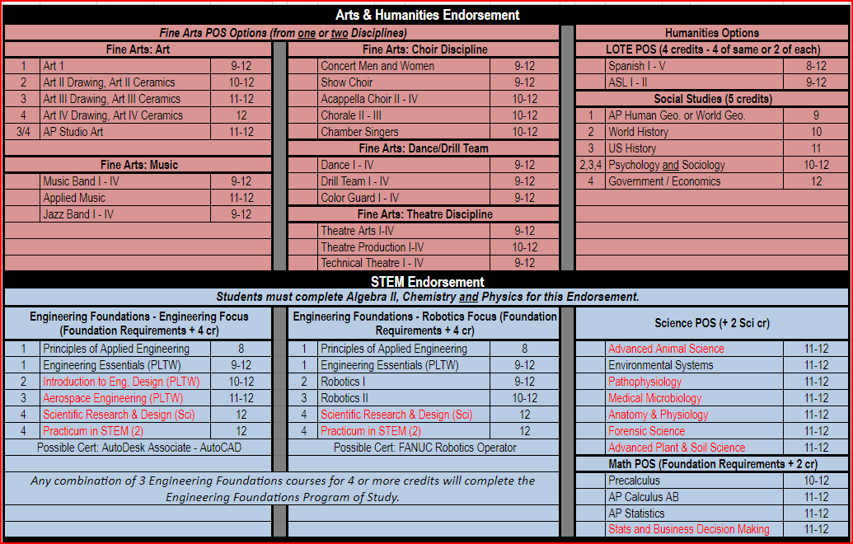
Endorsements:

Slide 9
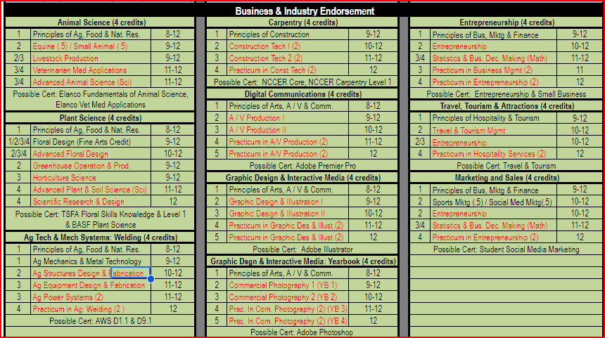
Endorsements

Slide 10
Endorsements

Slide 11
How do I make my schedule?
Review Graduation Requirements.
Review credits earned through Skyward or School Links.
Complete choices for your 4-year plan that meet all graduation requirements (this can be adjusted each year).
Go to the MFHS Counseling website and click on Scheduling tab – Use the course catalog to ensure you complete your chosen endorsement or use the School Links information to find your pathway to an endorsement. An endorsement is required to graduate.
Enter your choices in School Links! School Links course choices will complete your course requests for 11th grade. Choices 1-8 will be your requested courses. You must also choose alternates.
If you do not pick classes, including alternates, they will be selected for you and may not be able to change!

Slide 12
Log-in to School Links
Log-in to “Single Sign-on”.
Click on School Links. Log-in and complete the initial information.
Click on “School” link. Click on course planner.
Select continue if/when you see “Program of Study”.
Select the classes to complete your 4 year plan as we guide you through the process!

Slide 13
How to fill out your Course Requests
Stay with me and we will fill it out together.
Review credits needed to graduate and plan your course requests accordingly.
Click on “Add another Course” for (English, Math, etc.) and options will come up to pick from that content area.
You will choose courses to fill 8 academic hours and you will choose alternates.
You can use the short cuts at the top to toggle between content areas.

Slide 14
Choose your English course for next year:
English 1 Regular or Honors | English 2 Regular Honors | English 3 Regular, AP, UT OnRamps | English 4 Regular, Dual Credit, OnRamps or AP English 4
*Students interested in dual credit courses must fill out the required paperwork, pass the TSI and register for those classes through the college. See Mr. Teets or your counselor for more information.

Slide 15
Pick your English!
Pick your English course for next year.
If you failed a previous English course, you will be required to make that course up to graduate. You may select it here and/or see your counselor for more options.

Slide 16
Recommended Course Sequence for Math
9th Grade
10th Grade
11th Grade
12th Grade
Algebra 1
Geometry
Math Models
Algebra 2
Algebra 1
Geometry
Regular
Honors
Algebra 2
Regular
OnRamps
Pre-Calculus
Regular or OnRamps
or
Another 4th math
Geometry Honors
Algebra 2
OnRamps
Pre-Cal.
OnRamps
AP Statistics,
AP Calculus

Slide 17
Pick your math course for next year:
Pick your math course for next year.
2. If you failed Algebra 1 or Geometry, you will be required to make that
course up to graduate. You may select it here and/or see your counselor
for more options.

Slide 18
Course Sequence for Science
9th Grade
10th Grade
11th Grade
12th Grade
Biology
IPC
Chemistry
Physics or 4th Science
Biology
Chemistry
3rd Science
4th Science
Biology
Chemistry
Physics
4th Science
Biology Honors
Chemistry OnRamps
Physics, or Physics OnRamps
4th Science
*3rd and 4th year science course options are on the next slide, or in your course guide on the MFHS Counseling website.

Slide 19
3rd or 4th Year Science Options
If you failed Biology, IPC, Chemistry or Physics, you may be required to make that course up to graduate. See your counselor for options.
REGULAR COURSES
ADVANCED (weighted) COURSES
Environmental Systems
Medical Microbiology (offered every other year - even years only)
Pathophysiology (offered every other year - odd years only)
Forensics
Anatomy and Physiology
Advanced Plant & Soil Science
Engineer. design & Prob. Solving
Sci. Research & Design
Biology AP
Physics OnRamps - 1or 2
Chemistry OnRamps - 1or 2
Environmental Science AP (every other year)
Advanced Animal Science (DC)

Slide 20
Course Sequence for Social Studies
9th Grade
10th Grade
11th Grade
12th Grade
World Geography
or
AP Human Geography
World History or
World History AP
US History,
Reg., AP or OnRamps
Government and Economics
Reg., AP, OnRamps or Dual Credit

Slide 21
Pick your Social Studies courses:
Pick your Social Studies course!
Requirements: World Geography or World History, US History, Economics, and Government are required to graduate.
If you failed one of your previous Social Studies courses, you may select it here or see your counselor for more options.
World Geography AND World History are required to get the Multidisciplinary endorsement. You cannot substitute another Social Studies course (ex. Psychology or Sociology). You must also complete either Chemistry or Physics.

Slide 22
Elective requirements to graduate
You must have:
2 credits of the same foreign language
1 credit of fine arts
1 credit of PE or PE Equivalent
1 Endorsement – see endorsements in course catalog

Slide 23
Foreign Language
Students are required to have 2 years of the same foreign language to graduate.

Slide 24
Spanish Proficiency Exam
Students who plan to register for a Spanish course and already have some knowledge and skills in the language have the opportunity to advance to the upper level Spanish courses. Marble Falls ISD offers a proficiency and placement exam to determine knowledge and skill level required for entry into an upper Spanish course. A student may place out of courses based on the outcome of the exam, which includes an objective exam, writing, and speaking sample. Credits for courses placed out of may be awarded through the exam.
A student may also receive credit for Levels 1 and 2 by taking AP Spanish IV and receiving a score of 3 or better on the AP Spanish Language exam.
The Proficiency Exam is offered several times a year. To register for the exam, please see your counselor.

Slide 25
PE or PE Equivalent 1 credit required to graduate

Slide 26
Fine Arts 1 required to graduate

Slide 27
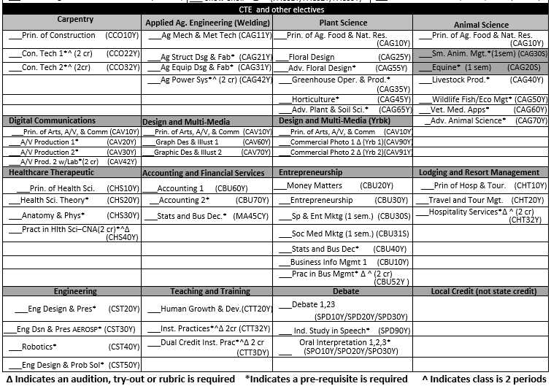
CTE and other electives Complete your endorsement!

Slide 28
Something to think about! Juniors and Seniors can have off-campus!
Juniors who meet specific criteria may be allowed one off campus period. Either 1st or 8th period.
Criteria includes:
1. Must have earned 16 or more credits before their Junior year.
2. Must be on track to graduate with an endorsement.
3. Must have passed all End-of-Course exams (EOCs/STAAR tests) the
student was eligible to take.
4. Must provide your own transportation to get on or off campus.
You cannot remain on campus during an off-period.

Slide 29
Check for accuracy
Make SURE you have 8 academic hours selected. Make SURE you have alternates in the order of preference. If you do not, we will select them for you.
School Links can be used at home to show parents your choices. You can make changes yourself until your Counselor meets with you in the hallway. After your Counselor confirms your classes, you must contact your counselor to request any additional changes.
The last day to submit ANY changes to your requests will be the last day of this school year (May 23).

Slide 30
Questions?

